Slide 1

ANZ Internship
Shashank Raj
PGPM in Analytics

Slide 2
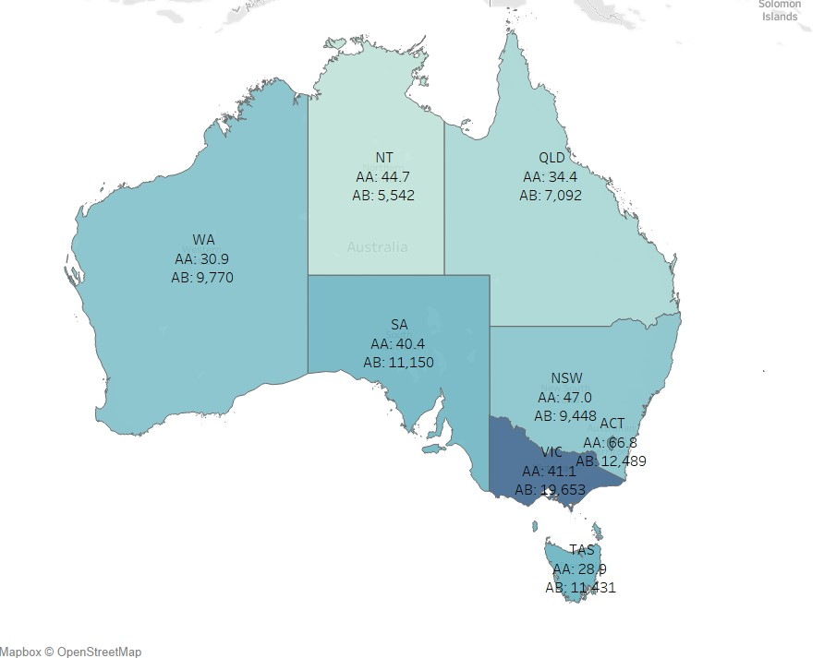
Task 1 : Geographical Analysis
Victoria has the highest average balance(19,653) while Northern Territory has the lowest(5,542).
Tasmania has the lowest average amount(28.9) while Australian Capital Territory has the highest(66.8).

Slide 3
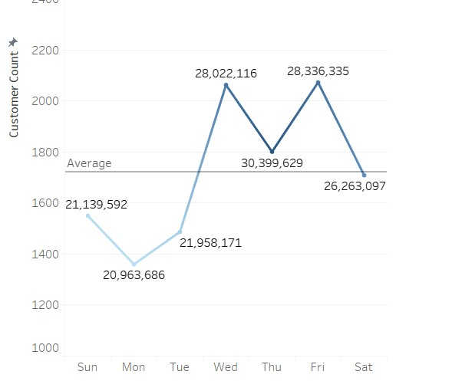
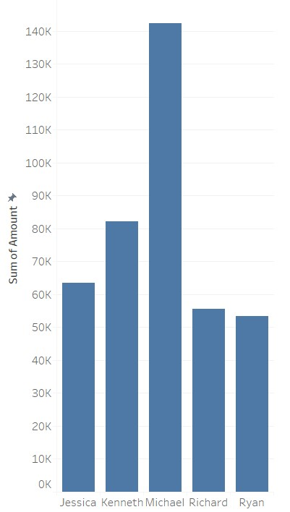
Task 1 : Customer Analysis
Thursday has the highest transaction amount but lower number of customers as compared to Wednesday and Friday.
Michael has made the highest amount of transactions, followed by Kenneth, Jessica, Richard and Ryan

